Slide 1
Nancy & Angular: The Warm Hug of Web Development
Brendan Graham
DDD Brisbane – 6 December 2014
Notes:
Welcome to the talk
Quick introduction about me
Brendan Graham
Senior developer at Readify where I’ve been working for close to 3 years now.
I’ve been a software developer for about 12 years now and my focus has been on web and azure for the past few years.
Most of the projects I’ve worked on recently have included Angular in the client, with many of those using Nancy on the server so I’ve become relatively familiar with both technologies. I’ve come to really enjoy using them both together.

Slide 2
Agenda
NancyFx
What is NancyFx?
Why should I choose NancyFx?
How do I NancyFx?
Code Demo

Slide 3
Agenda
AngularJs
What is AngularJs?
What can Angular do?
How does it do it?

Slide 4

What is Nancy?
Notes:
Started in 2010 by Andreas Håkansson, also known as @TheCodeJunkie on Twitter and GitHub.
Loosely based on the Ruby framework called Sinatra.
The main ethos that the authors have strived for is this “Super Duper Happy Path” which means everything should just work out of the box. You should be able to just fall into a successful solution without having to play with anything too much.

Slide 5
Small
Notes:
It’s made to be a small, low-ceremony framework for building HTTP based services running on .NET and Mono

Slide 6
Simple
Notes:
The goal of Nancy is to stay as far out of the way as possible and just let you deal with web requests.
The happy path for Nancy just works with no configuration at all.
You can start a new project, add your NuGet packages, add a Nancy Module and you’ve got a running web application.
It’s so simple, you can fit an entire Nancy Module, routing and all, in a tweet.

Slide 7
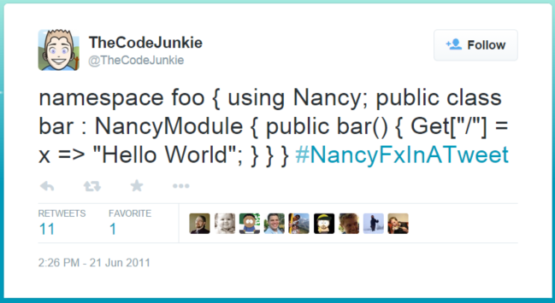

Slide 8
Self Contained
Notes:
It’s completely self contained.
No dependencies on any existing frameworks so there’s no need for System.Web or anything like that.
It’s built with the .NET Client Profile which makes it…

Slide 9
Flexible
Notes:
It will run nearly anywhere.
.NET Client Profile and the ability to listen to and respond over a port.
Integrated with Windows Service
Win Forms, WPF, or console applictions.
Existing ASP .NET applications like WCF, Web API, MVC or Web Forms.
You can use a netduino as a webserver.
You could theoretically run a webserver on your windows phone if you could find a way to listen to a port. You can’t by the way, but you could totes run up the webserver in an app without anyone being able to call it.
You could even run it anywhere that you can run Mono like a raspberry pi, or an Arduino.

Slide 10
Why Choose Nancy?
Notes:
- Apart from it being so small, simple and flexible, I think there’s plenty of reasons to choose

Slide 11
Customisable
Notes:
While the happy path for Nancy gives you something that you can work with really quickly, Nancy is incredibly customisable and modular. You can swap out and include any components you want.
By Default, nancy comes with Tiny IoC. Don’t like it? Swap it out. There’s nuget packages for Autofac, Ninject and Windsor.
This tends to be the philosophy with everything in Nancy. You can swap out authentication providers, hosting frameworks, view engines, boot strappers, validation support. There are plenty of different Nuget packages so you can build it in the flavour of your choosing. If you don’t like any of those, there’s interfaces to allow you to create your own custom implementations with plenty of supporting information on the internet to guide you.

Slide 12
Easy to test
Notes:
The Nancy authors took the “Super-Duper-Happy-Path” ethos to testing too.
You can easily create a custom bootstrapper for your application and with it, mock out whatever objects you need.
Nancy then gives you a browser object with which you can simulate HTTP Requests and have it go through the nancy pipeline using your custom bootstrapper and give you a response.
You can then inspect that response to assert whatever you’re expecting to see.

Slide 13
Community
Notes:
- There’s a large Nancy community out there with heaps of blog posts, documentation, tutorials, even a jabbr chat channel to get help from. People tend to be pretty quick to respond and help out where they can.

Slide 14
How Do I Nancy?

Slide 15
Modules
public class HelloWorldModule : NancyModule
{ }
Notes:
The main objects you’ll work with in Nancy are NancyModule’s
While Nancy isn’t an MVC framework, the easiest way to think of Nancy Modules are as Controllers.
They inherit from the NancyModule base class which is in the Nancy namespace
They also manage all their own routing internally.

Slide 16
Routing
public class HelloWorldModule : NancyModule
{
public HelloWorldModule()
{
Get["/"] = _ => "Hello World";
}
}
Notes:
Routing for a Nancy Module is all declared in the constructor.
Routes are set on property indexers in the NancyModule base class.
There’s a property for most of the HTTP methods so as I’ve used “GET” here, you can also have DELETE, HEAD, OPTIONS, POST, PUT and PATCH.

Slide 17
Routing
public class HelloWorldModule : NancyModule
{
public HelloWorldModule()
{
Get["/", runAsync: true] = async (_, token) =>
await Task.Run(() => "Hello Asynchronous World!");
}
}
Notes:
All methods can be run asynchronously by using specifying it in the route declaration.
There is an optional “runAsync” parameter on the indexer properties which gives you a cancelation token and allows you to run your func asynchronously.

Slide 18
Route Parameters
public HelloWorldModule()
{
Get["/"] = _ => "Hello World";
Get["/{name}"] = _ => "Hello “ + _.Name;
}
Notes:
- The underscore here is a dynamic object that contains all the route arguments, so we can use them to get the parameters.

Slide 19
Route Parameters
public HelloWorldModule()
{
Get["/"] = _ => "Hello World";
Get["/{name?World}"] = _ => "Hello “ + _.Name;
}
Notes:
These parameters allow you to do all kinds of stuff. You can make them optional, give them a default value like I have here.
The 2 get methods here will do exactly the same thing if I don’t supply a parameter.
I can also place a bunch of constraints on parameters to control what can be set. Constraints you get of the box are:

Slide 20
Parameter Constraints
Type Constraints
Get[“/{value:int}”]
Get[“/{value:decimal}”]
Get[“/{value:guid}”]
Get[“/{value:bool}”]
Get[“/{value:datetime}”]
Get[“/{value:datetime(dd-MM-yyyy)}”]
Notes:
Constraints to control the type of parameter value

Slide 21
Parameter Constraints
Integer Value Constraints
Get[“/{value:min(0)}”]
Get[“/{value:max(99)}”]
Get[“/{value:range(0,99)}”]
Notes:
Constraints to control an integer value

Slide 22
Parameter Constraints
String Value Constraints
Get[“/{value:alpha}”]
Get[“/{value:minlength(10)}”]
Get[“/{value:maxlength (200)}”]
Get[“/{value:length (10,200)}”]
Notes:
Constraints to control the format of a string value

Slide 23
Model Binding
Post[“/foo”] = _ =>
{
var model = this.Bind<ViewModelType>();
…
}
Notes:
- The simplest way to bind the form data to a model is to call the NancyModule Bind extension method.

Slide 24
Code Demo

Slide 25

What is AngularJS?
Notes:
Started in 2009
Version 1 came out June 2012
Maintained by google

Slide 26
Single Page Apps
Notes:
- Javascript framework to build Single Page Apps

Slide 27
MV*
Notes:
- It’s generally uses in an MVC pattern
- Can be used as MVVM with the “ControllerAs” syntax

Slide 28
What can it do?
Notes:
- Angular has everything you need to build SPA

Slide 29
Routing
Notes:
Routing provider to control loading different views and controllers
Full History

Slide 30
Views
Notes:
- It loads HTML view templates

Slide 31
2-way Data Binding
Notes:
To bind data between your Views and your models.
One time binding is also available

Slide 32
Factories
Notes:
- Factories to create objects

Slide 33
Services
Notes:
- Services to separate out your code

Slide 34
Controllers
Notes:
- Controllers to manage what’s going into your views.

Slide 35
Dependency Injection
Notes:
- Dependency Injection so you can use these factories and services in your controllers and other places.

Slide 36
jqLite
Notes:
jQuery Lite which is a slimmer version that Angular works with.
Works with full jQuery.

Slide 37
Testing
Notes:
- Angular was built with testing in mind so you can build some pretty robust tests around it.

Slide 38
How does it do it?

Slide 39
Directives
Notes:
Directives are a core concept in Angular.
Extend your markup with extra behaviours and information.
Added in 4 ways:

Slide 40
Directives
HTML Element Names
<date-picker />
Notes:
Directives are a core concept in Angular.
Extend your markup with extra behaviours and information.
Added in 4 ways:

Slide 41
Directives
HTML Element Attributes
<input type=“text” date-picker />
Notes:
Directives are a core concept in Angular.
Extend your markup with extra behaviours and information.
Added in 4 ways:

Slide 42
Directives
CSS Classes
<input type=“text” class=“date-picker” />
Notes:
Directives are a core concept in Angular.
Extend your markup with extra behaviours and information.
Added in 4 ways:

Slide 43
Directives
Comments
<!-- directive:date-picker -->
Notes:
Directives are a core concept in Angular.
Extend your markup with extra behaviours and information.
Added in 4 ways:

Slide 44
Directives
Notes:
Out of the box, there are a ton of directives for controlling angular itself.

Slide 45
Directives
<html ng-app=“myApp”>
…
</html>
Notes:
There’s a directive to tell angular to that you’re using an angular app.

Slide 46
Directives
<div ng-controller=“attendeeController”>
…
</div>
Notes:
A directive to tell angular which controller you’re using for an block.

Slide 47
Directives
<input type=“text” ng-model=“attendee.name” />
Notes:
A directive to bind a model property to your view.

Slide 48
Directives
<button type=“button” ng-click=“doStuff()” />
Notes:
Directives to run javascript from your model in response to an event.

Slide 49
Directives
<div ng-if=“isImportant” >
…
<div />
Notes:
Directives to control what needs to be displayed.

Slide 50
Directives
<ul >
<li ng-repeat=“attendee in attendees”>
…
</li>
<ul />
Notes:
And directives to control how to display it.
Most Angular directives will use this “NG dash” syntax to indicate it’s an angular directive.
Angular recommends that any custom directives that you build should use some prefix of some sort, just to guard against that becoming a reserved attribute in the future.
Another thing you may notice is directives may sometimes be written in different ways.

Slide 51
Directives
ng-repeat
ng_repeat
ng:repeat
data-ng-repeat
x-ng-repeat
Notes:
All of these do the same thing. Angular’s HTML compiler will resolve all of them to the ngRepeat directive.
The first way is the most common you’ll see though.

Slide 52
Controllers
<div ng-controller="attendeesController">
{{ name }}
</div>
angular.module(‘app’)
.controller(‘attendeesController’, [‘$scope’, attendeesController]);
function attendeesController($scope) {
$scope.name = “Brendan Graham”;
}
Notes:
Controllers are where you put a lot of the logic around what your view displays.
You will see markup like this typically in a view, but it can really anywhere.
It can also be nested inside other controllers
You declare what controller you’re pointing to with the ng-controller tag.
This will then give you a scope you can use to bind to.

Slide 53
Controllers
<div ng-controller="attendeesController">
{{ name }}
</div>
angular.module(‘app’)
.controller(‘attendeesController’, [‘$scope’, attendeesController]);
function attendeesController($scope) {
$scope = “Brendan Graham”;
}
Notes:
You then create your controller in JS like this.
This controller js function on the app module takes the name of the controller which is used to match the ngController directive.
The second parameter here accepts an array that tells angular everything that you need injected into the controller.
The last item in the list of items to be injected the controller function itself.
$scope is the item which you add all your methods and properties to your view.
There’s some implications in using $scope which I’ll go into soon, but angular have given us a different way to deal with it using the “ControllerAs” syntax.

Slide 54
Controllers
<div ng-controller="attendeesController as vm">
{{ vm.name }}
</div>
angular.module(‘app’)
.controller(‘attendeesController’, [attendeesController]);
function attendeesController() {
var vm = this;
vm.name = “Brendan Graham”;
}
Notes:
There’s a couple of differences here in the markup.
The ng-controller tag now has “as vm” to it, but this vm can be any name you want.
The binding now has vm dot in front of it meaning you’re specifically looking for that property on the View Model.

Slide 55
Controllers
<div ng-controller="attendeesController as vm">
{{ vm.name }}
</div>
angular.module(‘app’)
.controller(‘attendeesController’, [attendeesController]);
function attendeesController() {
var vm = this;
vm.name = “Brendan Graham”;
}
Notes:
In our javascript, we’re no longer injecting $scope into the controller.
Instead, we’re treating our controller as a view model and setting properties and functions on the controller itself which then become available on the ViewModel in your markup.
There’s a few advantages to this method.

Slide 56
Scope
<div ng-controller="attendeesController">
{{ name }}
<custom-date-picker ng-model=“dateOfBirth”>
{{ birthYear }}
</div>
</div>
Notes:
$scope itself can be a little ambiguous. Because of this concept of “Prototypal Inheritance”, any child scopes that you’re dealing with can be effected by changes to the parent scopes.
It can also make your code a little harder to read. This example has a custom date picker directive that is using the dateOfBirth property of the attendeesController’s scope.
Depending on how we’ve build our custom directive, the birthYear property can come from multiple places. It could come from the addressController, or it could come from a child scope that’s on the custom date picker directive itself.
If you can avoid using the scope directly, you could instead use it like:

Slide 57
Scope
<div ng-controller="attendeesController as attendeesVm">
{{ attendeesVm.name }}
<custom-date-picker ng-model=“attendeesVm.dateOfBirth”>
{{ dpVm.birthYear }}
</div>
</div>
Notes:
This is much clearer to me.
I can see exactly where everything is coming from. Properties for the attendees view model are clearly marked and birth Year is obviously a property of something else, in this case “dpVm”
While you can’t see “dpVm” declared here, it is declared in the Custom Date Picker declaration itself.

Slide 58
Code Demo

Slide 59
More Information
http://nancyfx.org
https://jabbr.net/#/rooms/nancyfx
#nancyfx or @nancyfx on twitter
http://angularjs.org
https://github.com/johnpapa/angularjs-styleguide
@angularjs on twitter

Slide 60
Thank you

Slide 61

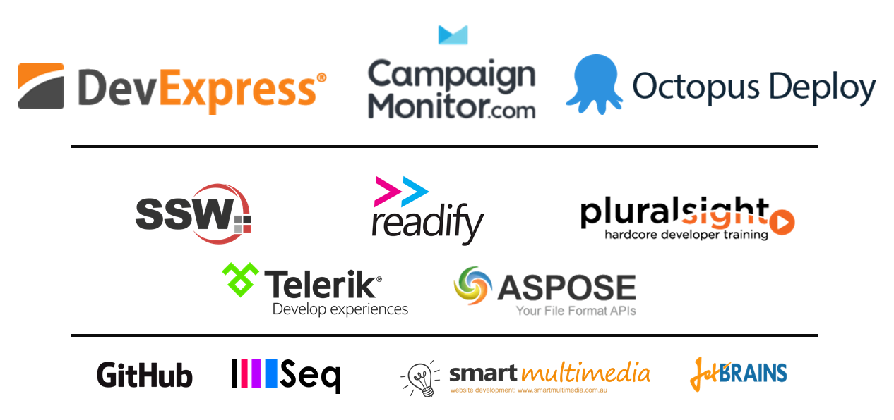
Contact
Brendan.graham@readify.net
@turtlator

